Slide 1
Well Come

Slide 2
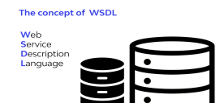
What is WSDL?

Slide 3

Introduction to WSDL
1) WSDL means Web Service Description Language.
2) WSDL use to Describe Web Service.
3) WSDL is Written in XML.
4) web service Description Language(WSDL) is an XML based
file that basically tells the client application what the web service is does.
5) WSDL was developed by jointly by microsoft and IBM.

Slide 4
Features of WSDL
- WSDL definations Describes how to access a web services and What operations it will perform.
- WSDL is language for Describing how to interface with XML based services.
- WSDL is an integral part of universal Description,Discovery and integration(UDDI),an XML-based worldwide business registry.
- WSDL is the language that UDDI is uses.
- WSDL is pronounced as “wiz-dull” and spelled out as “W-S-d-l”.

Slide 5
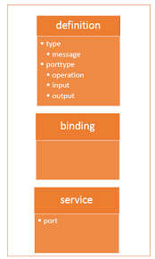
Structure of a WSDL Document
The WSDL file contains the location of the web services and
The method which are exposed by the web services.
The WSDL is very complex to any user,but it contain all the
Necessary information that any client apllication would require to use the relevant web services.
The WSDL is just like a postcard which has the address of particular location.
The WSDL file is the postcard, which has the address of the web service which can deliver all the functionality that the client wants.

Slide 6
WSDL Element
Definition − It is the root element of all WSDL documents. It defines the name of the web service,
Data types − The data types to be used in the messages are in the form of XML schemas.
Message − It is an abstract definition of the data being communicated.
Operation − It is the abstract definition of the operation for a message, such as naming a method, message queue, or business process, that will accept and process the message.
Port type − It is an abstract set of operations supported by one or more end-points.
Binding − It is the concrete protocol and data formats for the operations and messages defined for a particular port type.
Port − It is a combination of a binding and a network address, providing the target address of the service communication.
Service − It is a collection of related end-points encompassing the service definitions in the file.

Slide 7
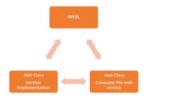
Why WSDL?
If the client application was written in .net it would understand the XML file.
Similarly,if the client application was written in java programing language than also it would be able to interpret the WSDL file.
The WSDL file is what binds everything together.

